Slide 1
Meal Management App
By William Curry
Mukesh Morampudi
Ryan Goettl

Slide 2
Problem Statement
The client requires an application that allows a user to manage a database of recipes based on its category and ingredients. It manages ingredients the users enters indicating they have those ingredients and the ingredients they still need for recipes. It also manages a meal plan for the user allowing them to pick meals based on recipes in the database for each meal of the day during the current week. The user will also be able to generate a shopping list containing the ingredients that the user does not already have in their fridge, based on their weekly meal plan.

Slide 3
Our Database
Our database is made up of 5 tables
Relational scheme:
Recipe(name, instructions, category) key: name
Ingredient(name, infridge, calories, sugar, fat, sodium, protein) key: name
Meal(id, name, mealtype, dayofweek) key: ID
RecipeIngredient(recipeName, ingredientName) key: recipeName ingredientName
RecipeMeal(recipeName, mealId) key: recipeName, mealName

Slide 4
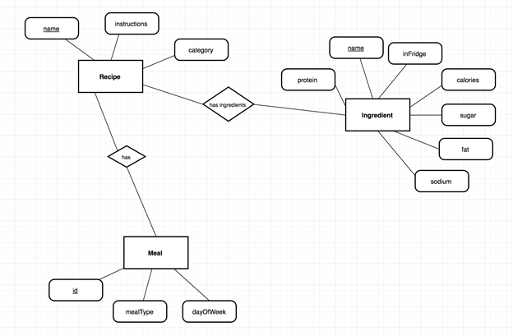
Our Database
ER Diagram

Slide 5
Our Database
We are using check constraints to ensure that only 'breakfast', 'lunch', and 'dinner are being inserted into Meal.mealType
Same for dayOfWeek and the days of the week ('monday', 'tuesday', etc.)
Ingredient.inFridge also has a check constraint to ensure that only 'Y', 'y', 'N', or 'n' are used.
We have a sequence for Meal.id that is updated via a meal_auto_inc trigger. Before every insert to Meal, the sequence is incremented to produce a new id value for the record.

Slide 6
Recipe Management
For recipes we included major ingredients needed, instructions, and the category
We also included a search function that works for multiple ingredients and a category
The user can add a recipe to the database

Slide 7
Ingredient management
We keep track of the ingredients in the fridge its name, group, calories, sugar, protein, sodium, fat
Users can add new ingredients but they must provide the information

Slide 8
Weekly Meal Management
Our meal system allows the user to select a day of the week then add any recipe they want for breakfast, lunch and dinner.
It will save the meal there and can be used again the next week or until it is changed.

Slide 9
Generate Shopping list
The system will generate a list of ingridents that are needed to make the meals from the weekly meal plan

Slide 10
Sources
http://stackoverflow.com/questions/2467070/onexit-event-for-a-swing-application
http://stackoverflow.com/questions/17459094/getting-id-after-insert-within-a-transaction-oracle
http://stackoverflow.com/questions/10929369/how-to-execute-multiple-sql-statements-from-java
http://stackoverflow.com/questions/21898425/how-to-use-cardlayout-with-netbeans-gui-builder

